Slide 1


Technology Roadmap

Slide 2

Shopify Atlas connects global shoppers with culturally authentic brands using AI-powered recommendations, creating personalized experiences that celebrate heritage and drive discovery.
Target Market: Globally-minded, culturally curious consumers aged 20-45 who frequently shop online, seeking authenticity and uniqueness.
Market Size & Potential: Cross-border e-commerce market projected to reach $7.9 trillion by 2030; specific target segment growth at 15% annually.
Key Trends:
Increased demand for authentic and ethical products.
Rise of personalized shopping experiences leveraging AI.
Expansion of accessible global payment and logistics.
Shopify Atlas
Traditional. Global. Now.

Slide 3
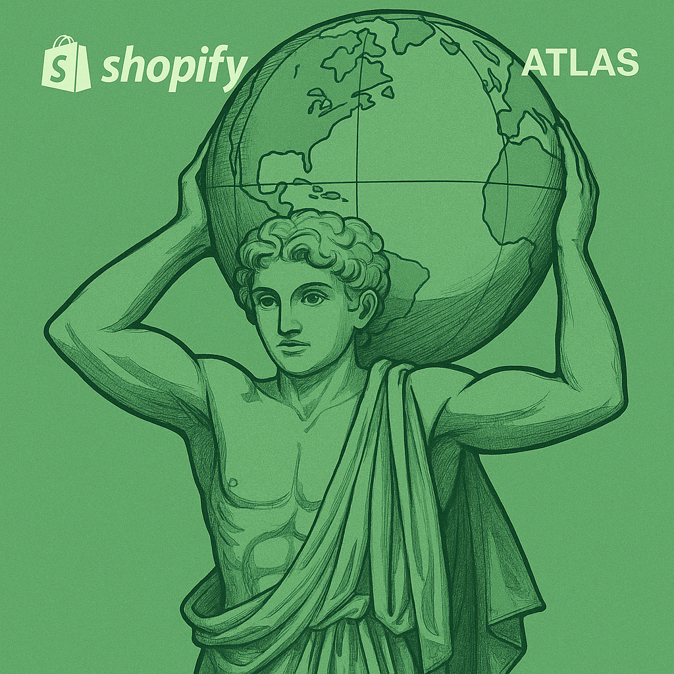


Minimum Viable Product
MVP
Features
Initial Value Proposition
An AI-powered cultural recommendation engine launching on Shopify’s platform.
Target Regions for MVP Launch:
🇰🇷 South Korea
🇧🇷 Brazil
🇰🇪 Kenya
🌍 Cultural Profiling:
AI analyzes purchase behavior, browsing activity, and demographics.
🤖 Smart Recommendations:
Algorithm curates culturally authentic product suggestions.
🔁 Learning Feedback Loop:
Real-time user engagement refines recommendations continuously.
For Customers:
🎯 Personalized Discovery:
Effortless access to culturally aligned, authentic products.
For Vendors:
📈 Niche Customer Reach:
Connects artisans with the right audience, expanding market access.

Slide 4


Long-Term Vision
From MVP to Global Cultural Commerce Ecosystem
Vision Statement: Building the world’s most personalized and immersive cultural commerce platform, redefining how consumers discover and engage with culturally authentic products through advanced AI-driven personalization engine.
Phase 1 (Year 1)
Phase 2 (Year 2-4)
Phase 3 (Year 4-5)
Launch and optimize MVP in 3 cultural markets
Regional Expansion & Advanced AI integration
Full Ecosystem & Immersive Commerce
• Build AI based Cultural Profiling • Hyper-Personalized recommendations • Feedback Loop for enhanced interactions
• Extended multi-regional rollout • Embedded Sentiment analysis through NLP • Branding Tools & Creator Empowerment
• Completely seamless AI Sidekick experience • Enhanced AR/VR Shopping Experiences • Transparent blockchain-enabled supply chains
Strategic Impact: • Hyper-personalized Customer Journeys • Industry Standard for AI-driven Cultural Shopping
• Empowerment of Local & Global Creators
• Ethical & Transparent Commerce via Blockchain

Slide 5

Business Case
Revenue Model:
Transaction Commissions: Tiered commission based on vendor sales.
Premium Placement Fees: Paid visibility through targeted ads.
Culturally Specific Ads: AI-driven ads based on cultural preferences.
Pricing Strategy:
Dynamic Pricing: Adjusts based on demand, regional economics, and market conditions, ensuring competitiveness
Performance-Based Fees: Discounts for top-performing vendors.
Break-Even & Revenue Growth:
Break-Even: Projected within 18-24 months post-launch.
Year-over-Year Growth: 25% after MVP launch, driven by expanding markets and increasing transaction volume.

Slide 6
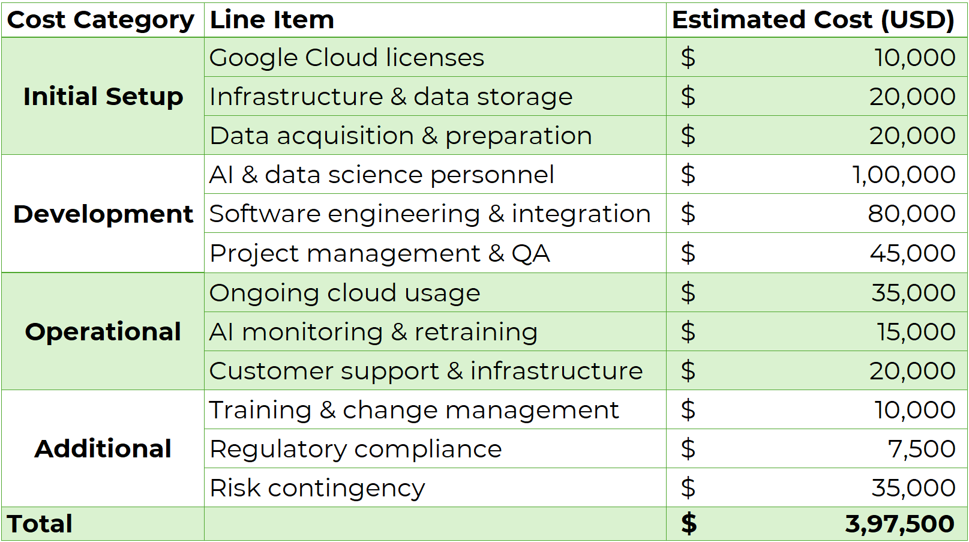
Business Case

Slide 7
Business Case
Conclusion: Key Success Factors
Authenticity & Personalization: AI-driven recommendations for diverse, authentic products.
Global Expansion: Reaching culturally curious consumers and vendors globally.
Operational Efficiency: AI automation streamlines operations, boosting profitability.
Path to Profitability
Scalability: AI improves with new markets, reducing costs and enhancing personalization.
Engagement: Authentic products and experiences drive transactions and premium services.
Efficiency: AI automates processes, increasing profitability.
Challenges & Mitigation
Cultural Sensitivity: Work with consultants and an Advisory Board.
Data Privacy: Ensure GDPR compliance and transparency.
Vendor Acquisition: Provide tools, flexible commissions, and support.
Scalability: Expansion requires more data, AI updates, and support.

Slide 8
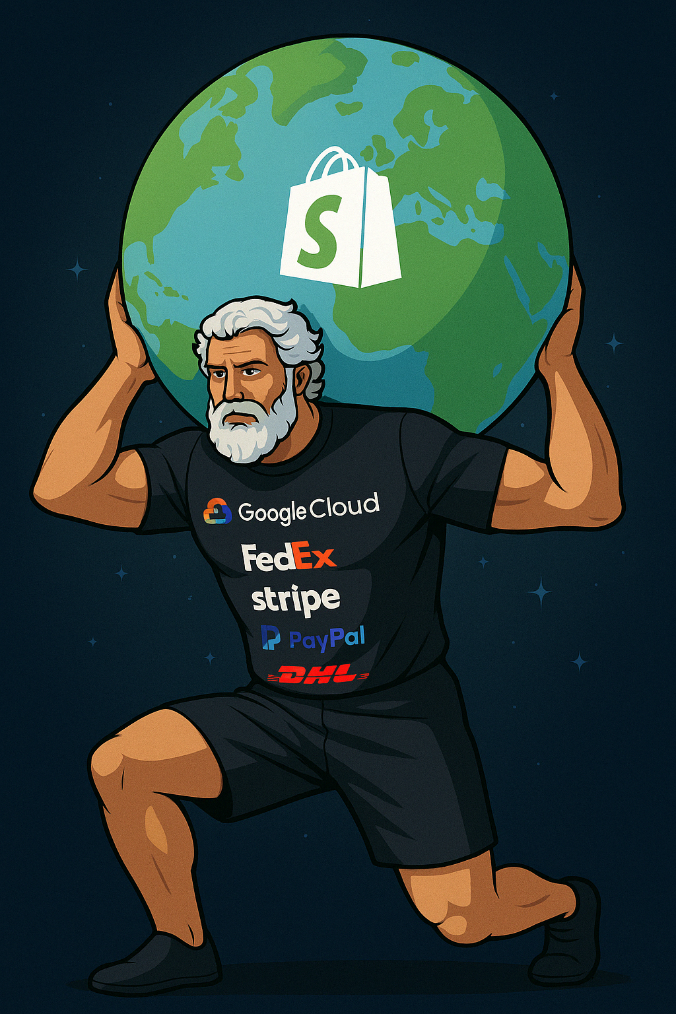
Implementation Approach
Technology Partners
Google Cloud - AI Backbone Gemini - Cultural Profiles Shopify Dev Teams - Platform Integration
Payments & Logistics
Stripe & PayPal – Global Payments DHL & FedEx – Reliable Shipping Local Partners – Last-Mile Delivery
Product & Vendor Partners
Ensuring Authenticity Onboard Anchor Merchants Offering Support to Merchants
Cultural Oversight
Advisory Board for Oversight Guide Ethical Representation Appraise Products & Merchants

Slide 9
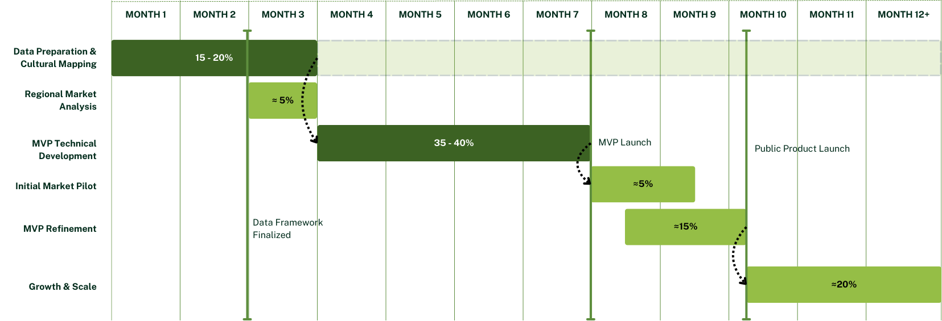

Execution Plan

Slide 10



Execution Plan
Data Preparation & Cultural Mapping
Gather historical purchase data and product metadata
Tag products with cultural attributes using expert input and NLP
Identify sentiment and contextual cues (e.g. “celebratory” vs. “traditional”)
Regional Market Analysis
Utilize AI agents to conduct deep market research
Identify local cultural vendors to onboard for the MVP
MVP Technical Development
Build cultural profiling model using behavioral and contextual data
Integrate into Shopify backend (Google Cloud, APIs, data streams)
Develop basic UI for personalized product discovery
Internal testing and compliance auditing

Slide 11

The Future of Global Commerce Starts Here
Value Proposition: Shopify Atlas delivers personalized, AI-powered access to authentic cultural products, transforming how people shop and connect across borders.
Vision & Impact: To become the global leader in cultural e-commerce - bridging cultures, empowering artisans, and creating deeply human, tech-enabled shopping experiences.
Ask:
Approval and Funding to scale MVP & global reach
Collaborators to build the future of cultural commerce
Call to Action: Let’s strive to launch Shopify Atlas. Together, we can revolutionize commerce through culture.
Shopify Atlas
Traditional. Global. Now.
Shopify Atlas is more than commerce - it's connection

Slide 12

THANKS
ASANTE 감사해요
OBRIGADO
Zachary Walsh (CDG)
Dhiraj Manicketh (CFF)
Maurya Shah
Poorav Desai
Adit Khalkar
Pratik Nesarkar

